Slide 1
Moving Towards Implementation

Slide 2
Moving Towards Implementation
Modeling dynamic behaviour of a system allows to represent, visualize, depict and document the changing parts of the system.
In the interaction diagrams, the interaction among a set of objects to accomplish a given use case scenario is depicted.
The behaviour of the operations and state of the objects may be modeled using activity diagrams and state chart diagrams before starting the implementation.

Slide 3
Moving Towards Implementation
This intermediate step will help us to bridge the gap between design and implementation.
The behaviour of the operation may become transparent for the purpose of implementation.
The state of the objects are depicted along with inputs and outputs produced based on these inputs.
This will enhance the understanding of the system and may provide a strong foundation for implementation particularly in the new areas of implementation and technology.

Slide 4
Activity Diagrams
The dynamic aspects of a system are modeled through activity diagrams.
Activity diagrams are used to model the working of a process or an operation.
The activities carried out in a process/workflow or operation are depicted in an activity diagram.
Activity diagrams enable to visualize, understand, and document the flow of activities in an operation or process.

Slide 5
Activity Diagrams
Activity diagrams have many applications and they are used to:
  increase the understanding of a business model, process or a use case.
  determine the objective for business related e-commerce applications.
  to simplify a given operation.

Slide 6
Activity Diagrams
Activities and Transitions
An activity represents execution of a step or set of steps in a process or an operation.
Activity may be atomic or may consist of multiple steps.
An activity either manual or automated is used to complete a given task.
Transition represents the path from one activity to another activity.
An activity is represented by an oval shaped circle with rounded ends and a transition is represented by a directed line.

Slide 7
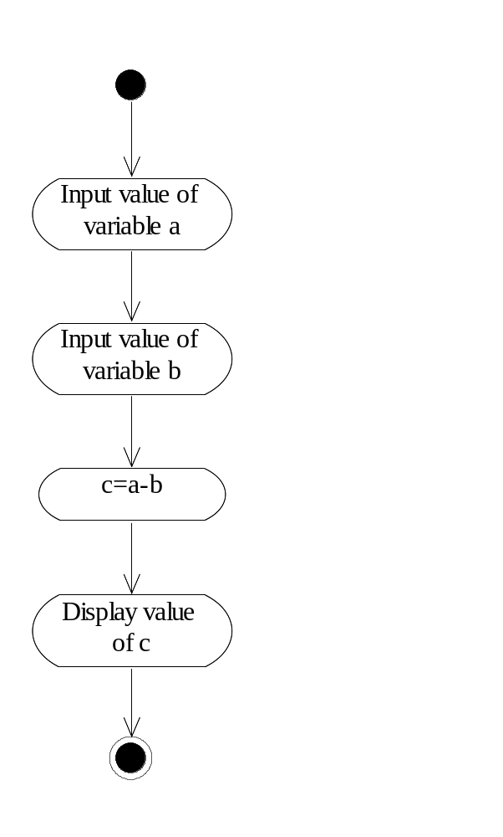
Activities and Transitions for subtracting two numbers

Slide 8
Activity Diagrams
Branching
Branching is used for making decisions in an activity diagram.
A branch consists of a guard condition that is used to control which activity should be followed from a set of alternative activities once the current activity is completed.
Similar to a flowchart, a boolean expression (guard condition) depicted in brackets is used to take decision about which alternative path to follow.

Slide 9
Activity Diagrams
Branching
The decision branch is represented by a diamond with one incoming transition and more than one outgoing transitions.
On each outgoing transition a guard condition is specified.
The activity corresponding to the outgoing transition that meets the guard condition will be executed.

Slide 10
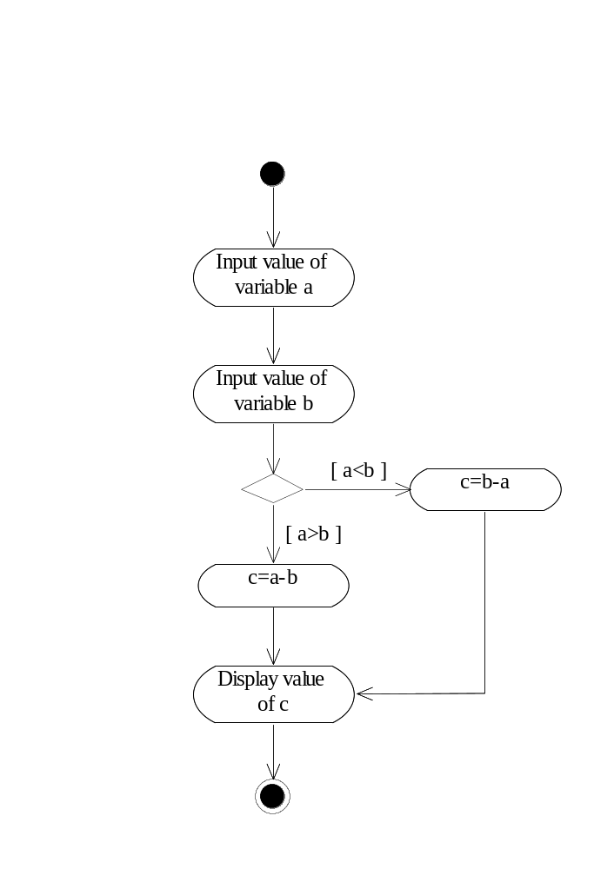
Activity Diagrams

Slide 11
Activity Diagrams
Modeling Concurrency
When modeling a process, we may encounter concurrent flows. In UML, concurrent flows are depicted by synchronization bar to represent fork and join of parallel activities.
A synchronization bar is represented by a thick horizontal line. Fork divides the activities into two or more concurrent sub activities.
A fork may consist of one incoming transition and more than one outgoing transitions. Join combines the two or more concurrent flows when they are completed. Join is used for synchronization of concurrent activities.

Slide 12
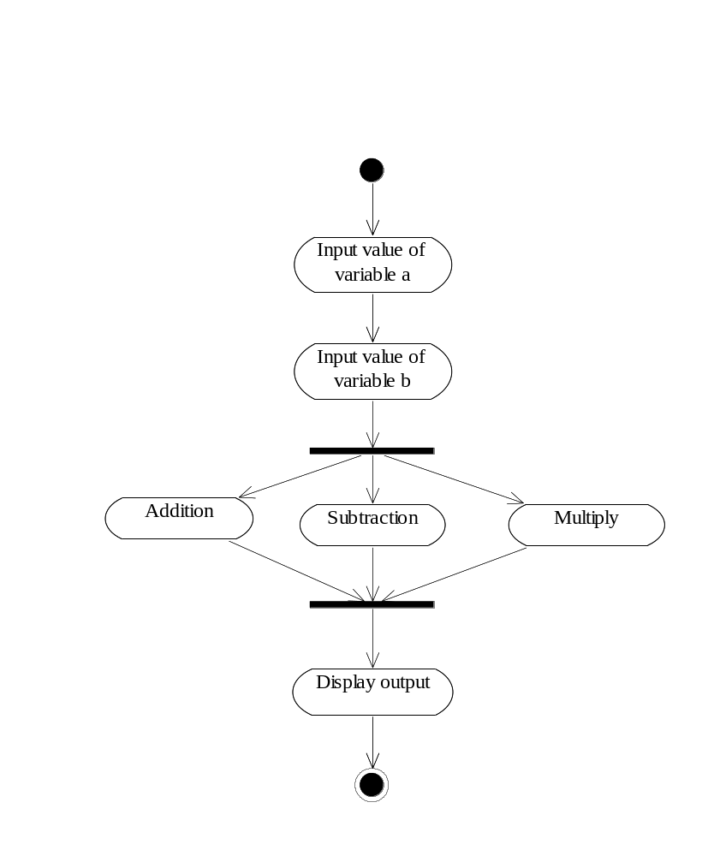
Modeling concurrent activities

Slide 13
Activity Diagrams
Using Swimlanes
A swimlane groups all the activities that are carried by the owner of the swimlane.
Swimlanes are used to determine which business entity is responsible for carrying out a specific activity.
Each swimlane is represented by a unique name. The transitions may cross between entities in the swimlanes. Swimlanes are represented by vertical lines that divide each group from its neighbours. For example a system may have the following three swimlanes as shown in the next figure :
Manager: The activities residing in this swimlane shows the activities for which the manager is responsible. As shown in figure the manager enters data.
System: The activities residing in this swimlane shows the activities for which the system is responsible. The system generates the requested report.
Printer: The activities residing in this swimlane shows the activities for which the printer is responsible. The printer prints the report generated by the system.

Slide 14
Activity Diagrams
Using Swimlanes
For example a system may have the following three swimlanes:
  Manager: The activities residing in this swimlane shows the activities for which the manager is responsible.
  System: The activities residing in this swimlane shows the activities for which the system is responsible. The system generates the requested report.
  Printer: The activities residing in this swimlane shows the activities for which the printer is responsible. The printer prints the report generated by the system.

Slide 15
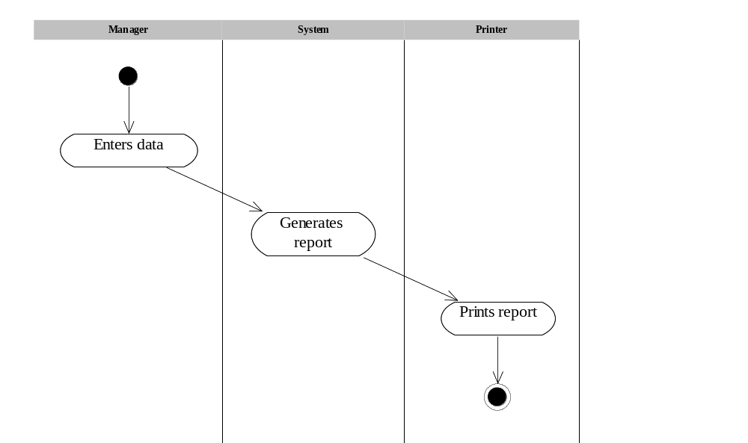
Activity Diagrams

Slide 16
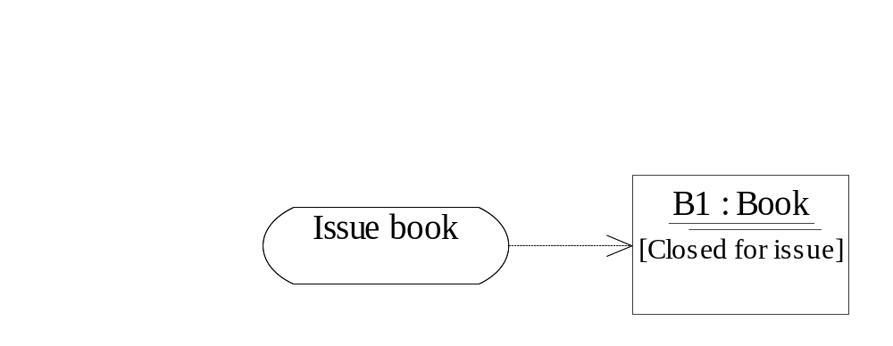
Activity Diagrams
In an activity diagram objects may be involved to represent the changes in the object because of an activity. For example, issue book activity changes the state of Book object to ‘closed for issue’.

Slide 17
Activity Diagrams
Uses of Activity Diagrams
Activity diagrams can be used to model a system as a whole, a process, a use case, or an operation. It can be used in the following ways:
  for modeling a workflow or process
  There are many business processes that consist of activities that need to be followed throughout the process. The following steps may be carried out to model a workflow or a process.
    Determine the business entities that will participate in the activity diagram.
    Identify the initial state with its preconditions and final state with its post conditions.
    Specify the activities that will take place.
    Provide separate activity diagram for each complete activity.
    Identify decisions, and concurrent flows.
    Show the changing values of objects in the activity diagram.

Slide 18
Activity Diagrams
For example, consider an E-commerce application for purchasing an item from Internet. The following steps are followed:
  Customer selects the items to be purchased.
  Customer adds the items in the shopping cart.
  Customer places an order.
  Vendor receives the order.
  A secure payment gateway asks for customer’s credit card details.
  Customer provides his/her details to the payment gateway.
  Credit Card Company verifies the customer’s details and approves the transaction.
  Vendor confirms the order.
  Vendor communicates with warehouse that ships the order to the customer at the specified shipping address.
  The credit card company sends the bill to the customer for payment.

Slide 19
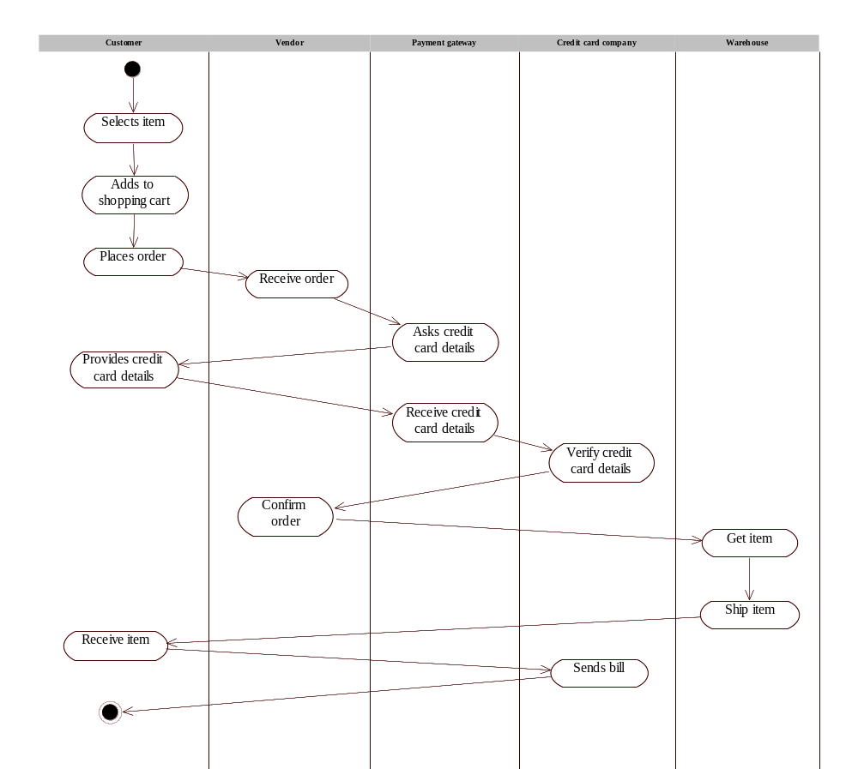

Slide 20
Activity Diagrams
To model a use case
Each use case represents functionality of the system. We can depict the flow of the use cases by using the activity diagram. In order to create an activity diagram of a use case the following steps should be followed:
  Identify the pre conditions and post conditions of the use case as given in use case diagram.
  Identify beginning of the use case.
  Identify the activity that will take place in the use case.
  Keep the activities simple and understandable.
For example, consider ‘maintain book details use case of LMS.

Slide 21
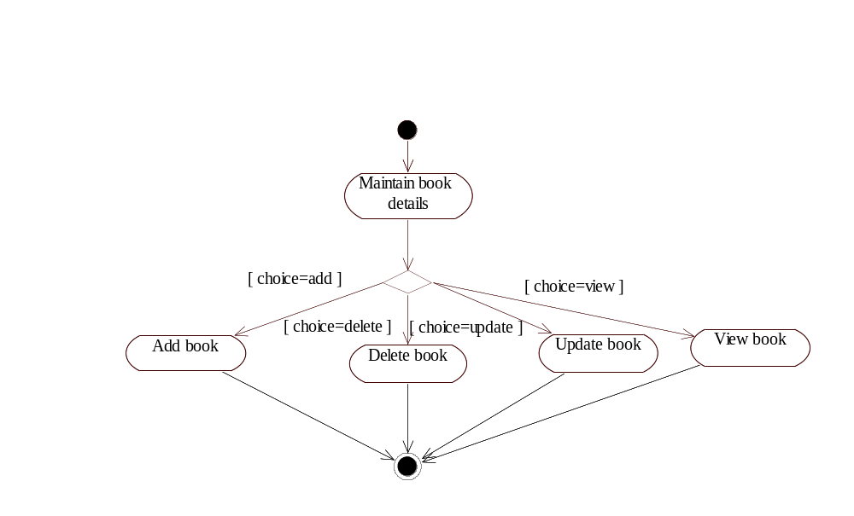
Activity Diagrams

Slide 22
Activity Diagrams (Returning a Book )
First, the current date is retrieved. Then, there is a guard condition that checks whether the member is student of faculty/employee.
If the member is student, then the expected date of return is incremented by 15 days with respect to the current date.
Otherwise, the operation adds 30 days in the current date. Finally the transaction is saved to the database.

Slide 23
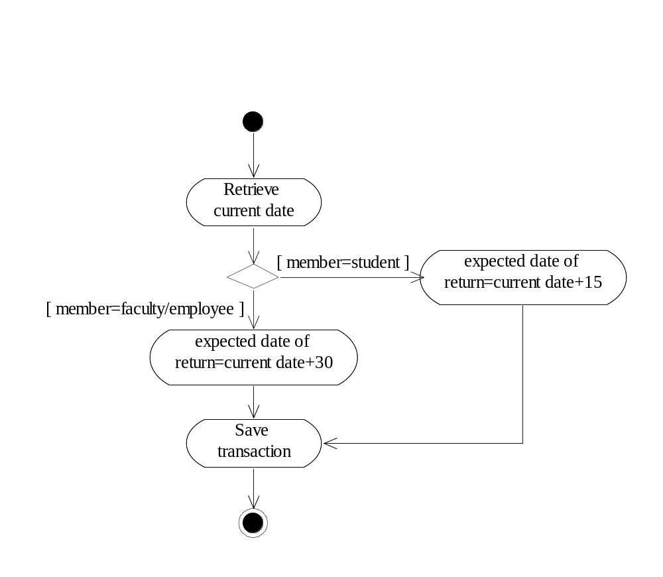
Activity Diagrams

Slide 24
Activity Diagrams
Example: Consider an operation to calculate area of a triangle. Construct activity diagram for this operation.

Slide 25
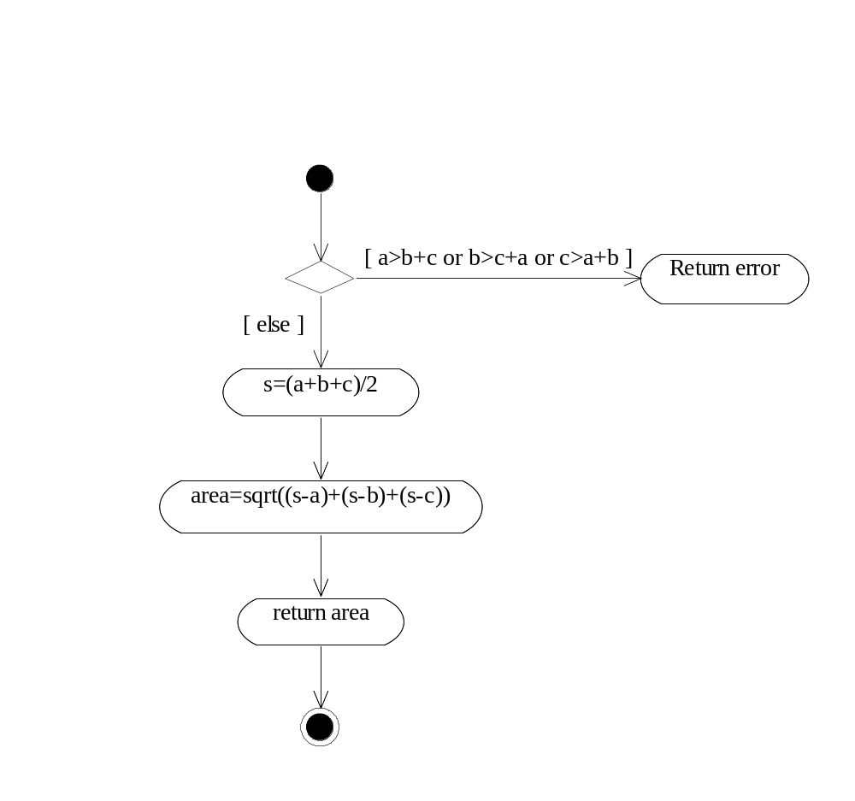

Slide 26
Activity Diagrams
Example: Consider a calculateFine operation of Transaction class in the library. Construct activity diagram for this operation.

Slide 27
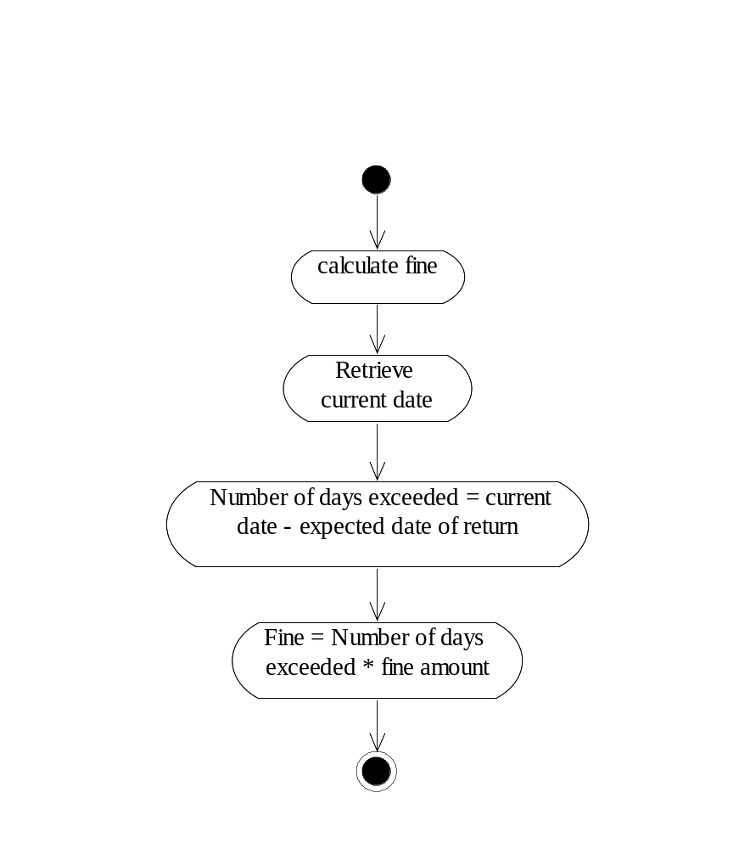

Slide 28
Statechart Diagrams
Likewise activity diagrams, statechart diagram also models the dynamic aspects of the system.
These diagrams are used to model the life cycle of the object, from the time it is created until the object is destroyed.
The difference between activity diagrams and statechart diagrams is that statechart diagrams are based on states and activity diagrams are based on activities.
A statechart diagram models the states of an object’s lifetime whereas activity diagrams are used to model the sequences of activities in a process or an operation.

Slide 29
Statechart Diagrams
Statechart diagrams are created to model the classes which have significant dynamic behaviour.
A class is said to have a significant dynamic behaviour if it goes through multiple states.
The transition causes an object to move from one state to another state.
For example, consider a faculty member in the university. If the person is in the relationship with the university, then the status of the person is employed.

Slide 30
Statechart Diagrams
Otherwise the person may be expelled or retired from the university.
These models will help the developers so that may obtain a clear understanding of the dynamic behaviour of the object. These diagrams are very useful for modeling reactive systems.

Slide 31
Statechart Diagrams
States and state transition
A state is one of the conditions that an object may satisfy during its lifetime. In the given state, the object may perform some activity or waits for some event to happen.
The state of the object may be determined by one of the possible value of the attributes of the class.
For example, in LMS an object of Book class may be open for issue (able to issue the book to a member) or close for issue (the book cannot be issued).

Slide 32

Statechart Diagrams
States and state transition
A state is represented by a rectangle with rounded ends.

Slide 33
Statechart Diagrams
States and state transition
State transitions represent the change of an object from one state to another state.
Likewise activity diagrams, the state transition are represented by a directed line. In UML, state may also consist of entry action, do activity and exit action.
Entry action takes place when the object enters a given state.
The do specifies the task/activities that must be performed while in the current state and continues until the state is exited.
The entry and exit actions are preceded by a word entry/exit followed by a ‘/’(slash)

Slide 34
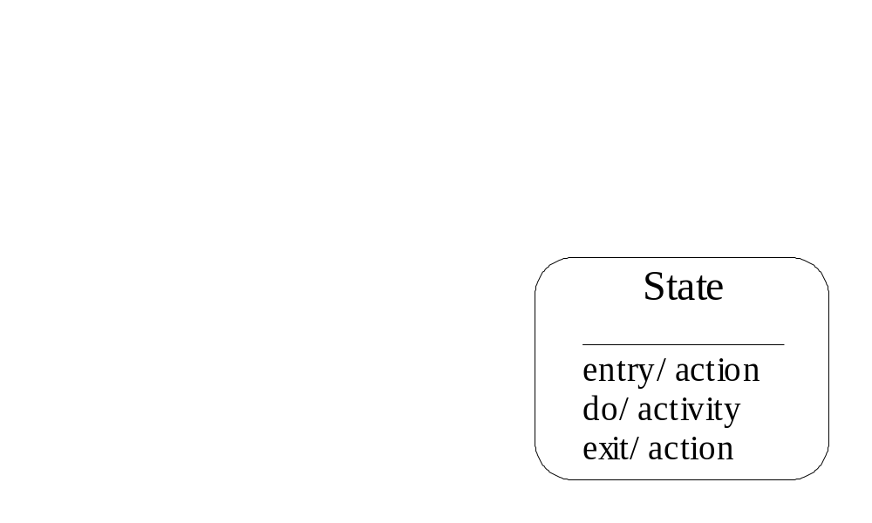
Statechart Diagrams
States and state transition

Slide 35
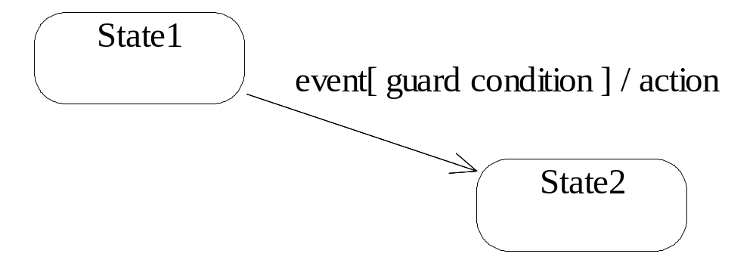
Statechart Diagrams
Event, Action and Guard Condition
A state transition may be associated with an event, action or guard condition.
The notations used to depict these three associations with state transition.

Slide 36
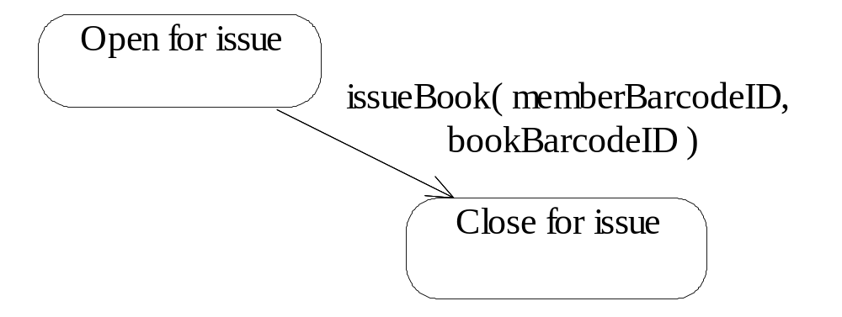
Statechart Diagrams
Event, Action and Guard Condition
An event is a message that is sent from one object to another object. In the statechart diagram, an event can be shown using operation name on the state transition.
The operation may consist of arguments. The operation may be a message from some other object. For example, Library Staff requests issue of book, the event moves the book from open for issue state to close for issue state

Slide 37
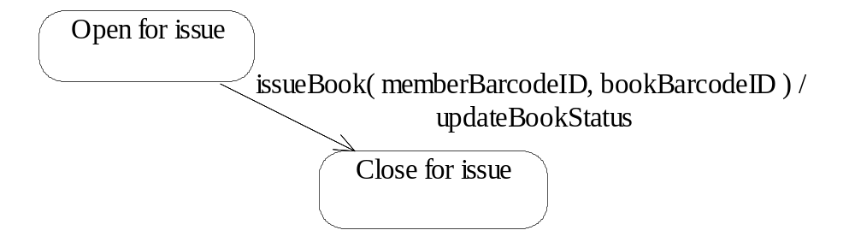
Statechart Diagrams
Event, Action and Guard Condition
An action is a behaviour that occurs in response to a state transition.
These actions become the operation of the object.
All actions are noninterruptible and are shown along with state transition after the event name separated by ‘/’ (slash).

Slide 38
Statechart Diagrams
Event, Action and Guard Condition
A guard condition is a boolean expression that tests whether the condition is true or not.
If the condition is true then the state transition is done, otherwise not.

Slide 39
Statechart Diagrams
Modeling Lifecycle of an Object
The primary use of statechart diagram is to model the life cycle of an object.
The interaction diagrams model the interaction between objects working together whereas statechart diagram models states through which a single object goes through during its life cycle.
The activity diagrams are used to model the sequence of activities of a process whereas statechart diagrams are used to model states of an object.
The dynamic aspects of a class use case or a system can be modeled by identifying their dynamic or reactive objects. Hence, the most common use of the statechart diagrams is to model the dynamic objects.

Slide 40
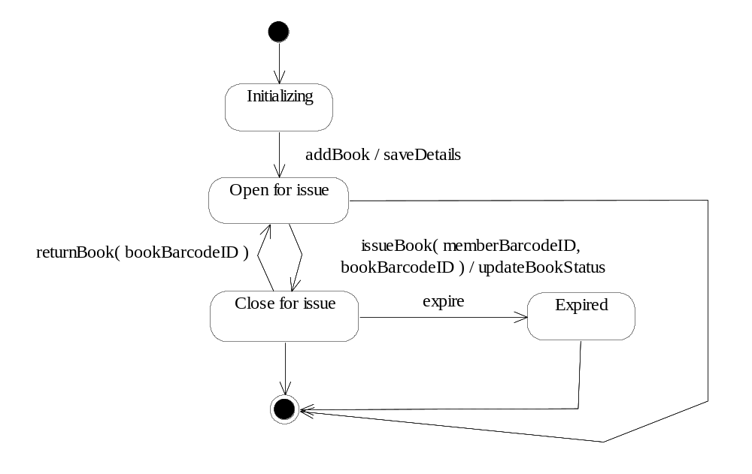
Statechart Diagrams

Slide 41
Statechart Diagrams
Creating Substates
Substates are nested inside other states.
The substates are also referred to as nested states and the outer state is referred to as superstate.
A simple state has no substate whereas a super state is composed of two or more nested states.
For example, a printer in its startup state might be both heating and initializing.
Thus, starting up is a super state and heating and initializing may be two substates. The superstate reduces the complexity of the state transition diagram.

Slide 42
Statechart Diagrams
Creating Substates
For example, consider an ATM system.
It consists of three basic states: idle (when no customer transactions are being carried out), processing (when customer transaction is being executed) and switched off (when either ATM is out of service or for switched off due to maintenance purposes).
After reading the card, the customer details are validated, and customer selects the desired transaction which is processed by the bank followed by printing of receipt. Finally the card is ejected and ATM system moves back to the idle state.

Slide 43
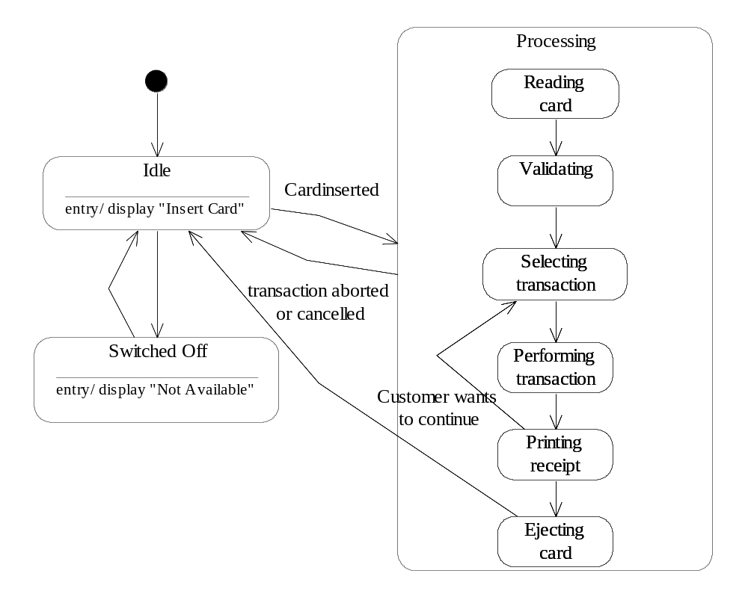

Slide 44
Statechart Diagrams
Creating Substates
The history state can be specified in a superstate.
This state enables the control to remember the point in last active state, if due to any reason the superstate is to be left.
There may be times when before leaving the superstate we want to remember the last active substate of an object.
For example, consider a process, it consists of four basic states ready, running, waiting, terminated. The running superstate has three substates initializing, executing, and exiting.
  Now, if a process is interrupted in between the execution, the control must remember the last active state of the process.

Slide 45
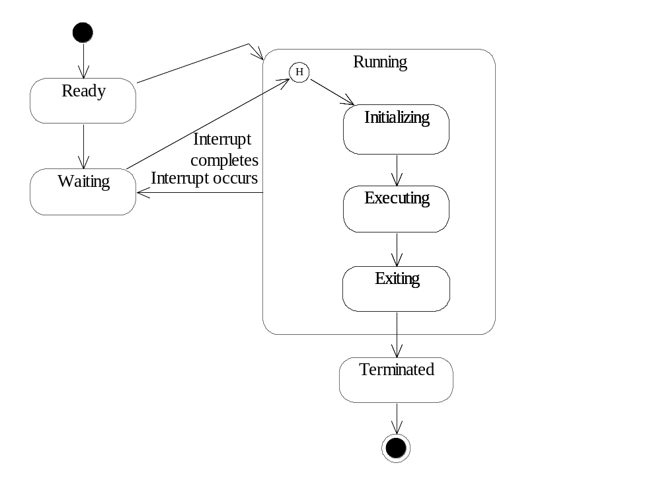

Slide 46
Statechart Diagrams
Example:
Consider University Registration System, students are registered in the beginning of each semester. The registration must be completed by the students within 15 days of the start of the registration process. Draw statechart diagram showing the states of registration.

Slide 47
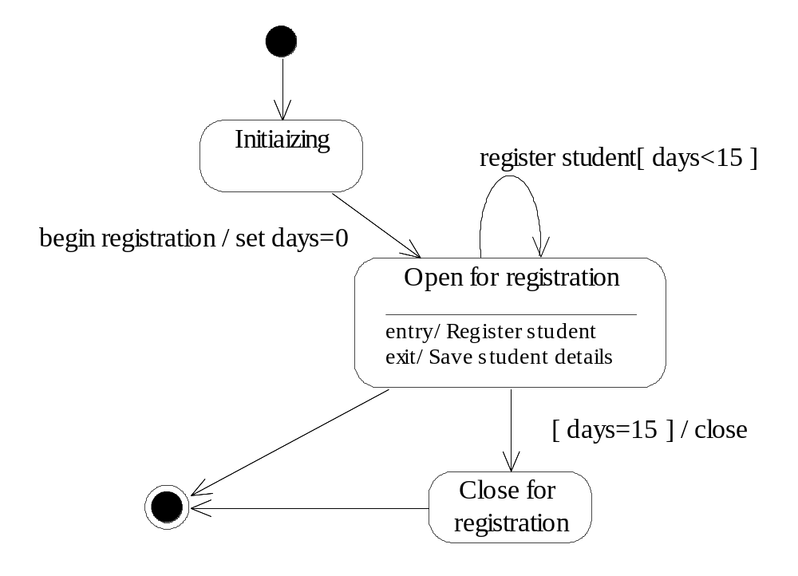
Statechart Diagrams

Slide 48
Statechart Diagrams
Example:
Consider an E-commerce application for purchasing an item from Internet. The state of order class needs to be checked in this application. The orders are processed after being initialized. The order may get canceled by the customer. Draw statechart diagram showing the states of order class.

Slide 49
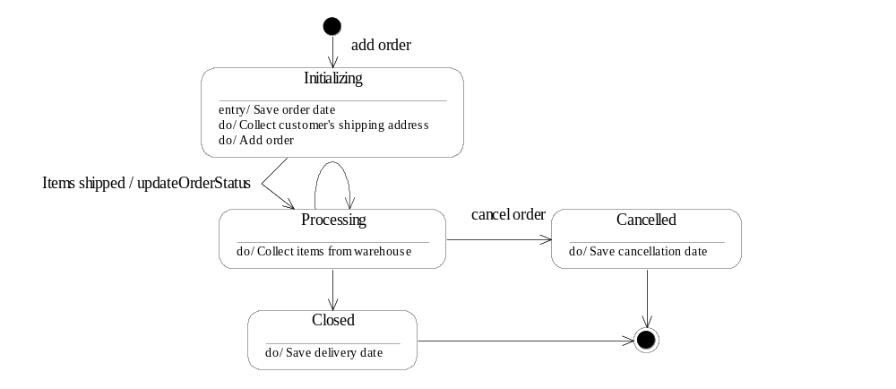
Statechart Diagrams

